Slide 1
Team One Advent Calendar
Tejas, Anushree, Pratima, Thenuri, JD

Slide 2
Idea & Organisation
We wanted our advent calendar to be interactive and fun
We decided to make a riddle advent calendar with an encoded Christmas message that would be decoded throughout the month
We set up weekly/biweekly meeting
We split our tasks and worked both independently and as a group with pair programming

Slide 3
Tech Stack
We decided to use JavaScript as our scripting language as it works better with web development and works well with both HTML and CSS which we wanted to use for web design aspects
As the team had less experience using JavaScript, we decided this would also be a good learning exercise for the team
We used GitHub repository to allow collaboration
VS Code extensions: Go Live - Used to open live page

Slide 4
Decoder
A B C D E F G H I J K L M N O P Q R S T U V W X Y Z
Santa TBOUB
Mistletoe NJTUMFUPF
Ornaments PSOBNFOST

Slide 5
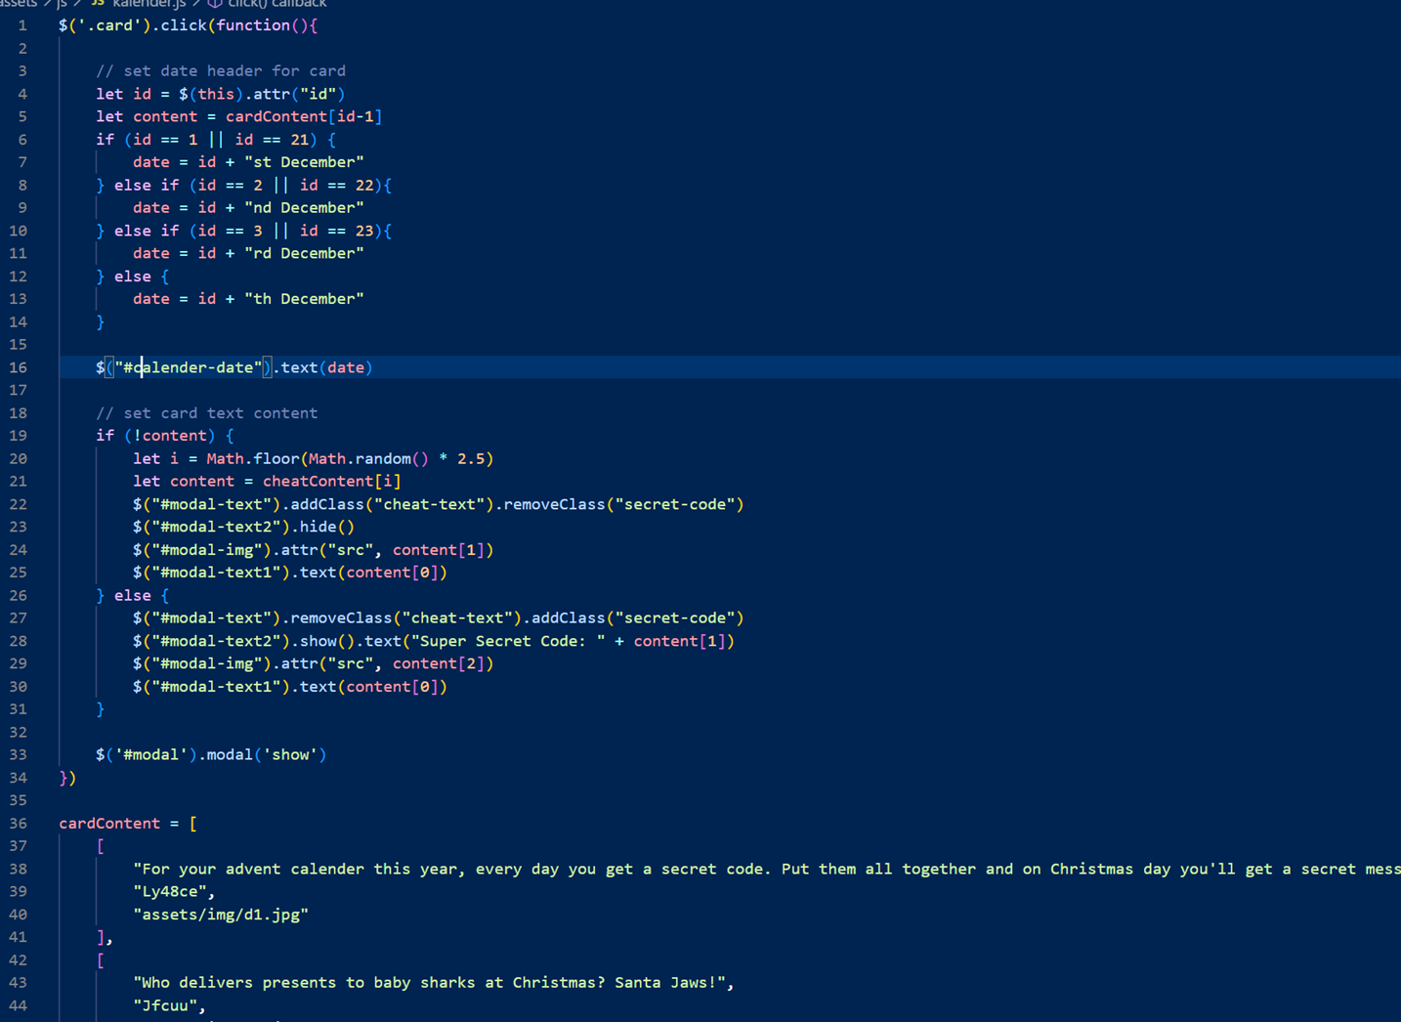
Logic

Slide 6
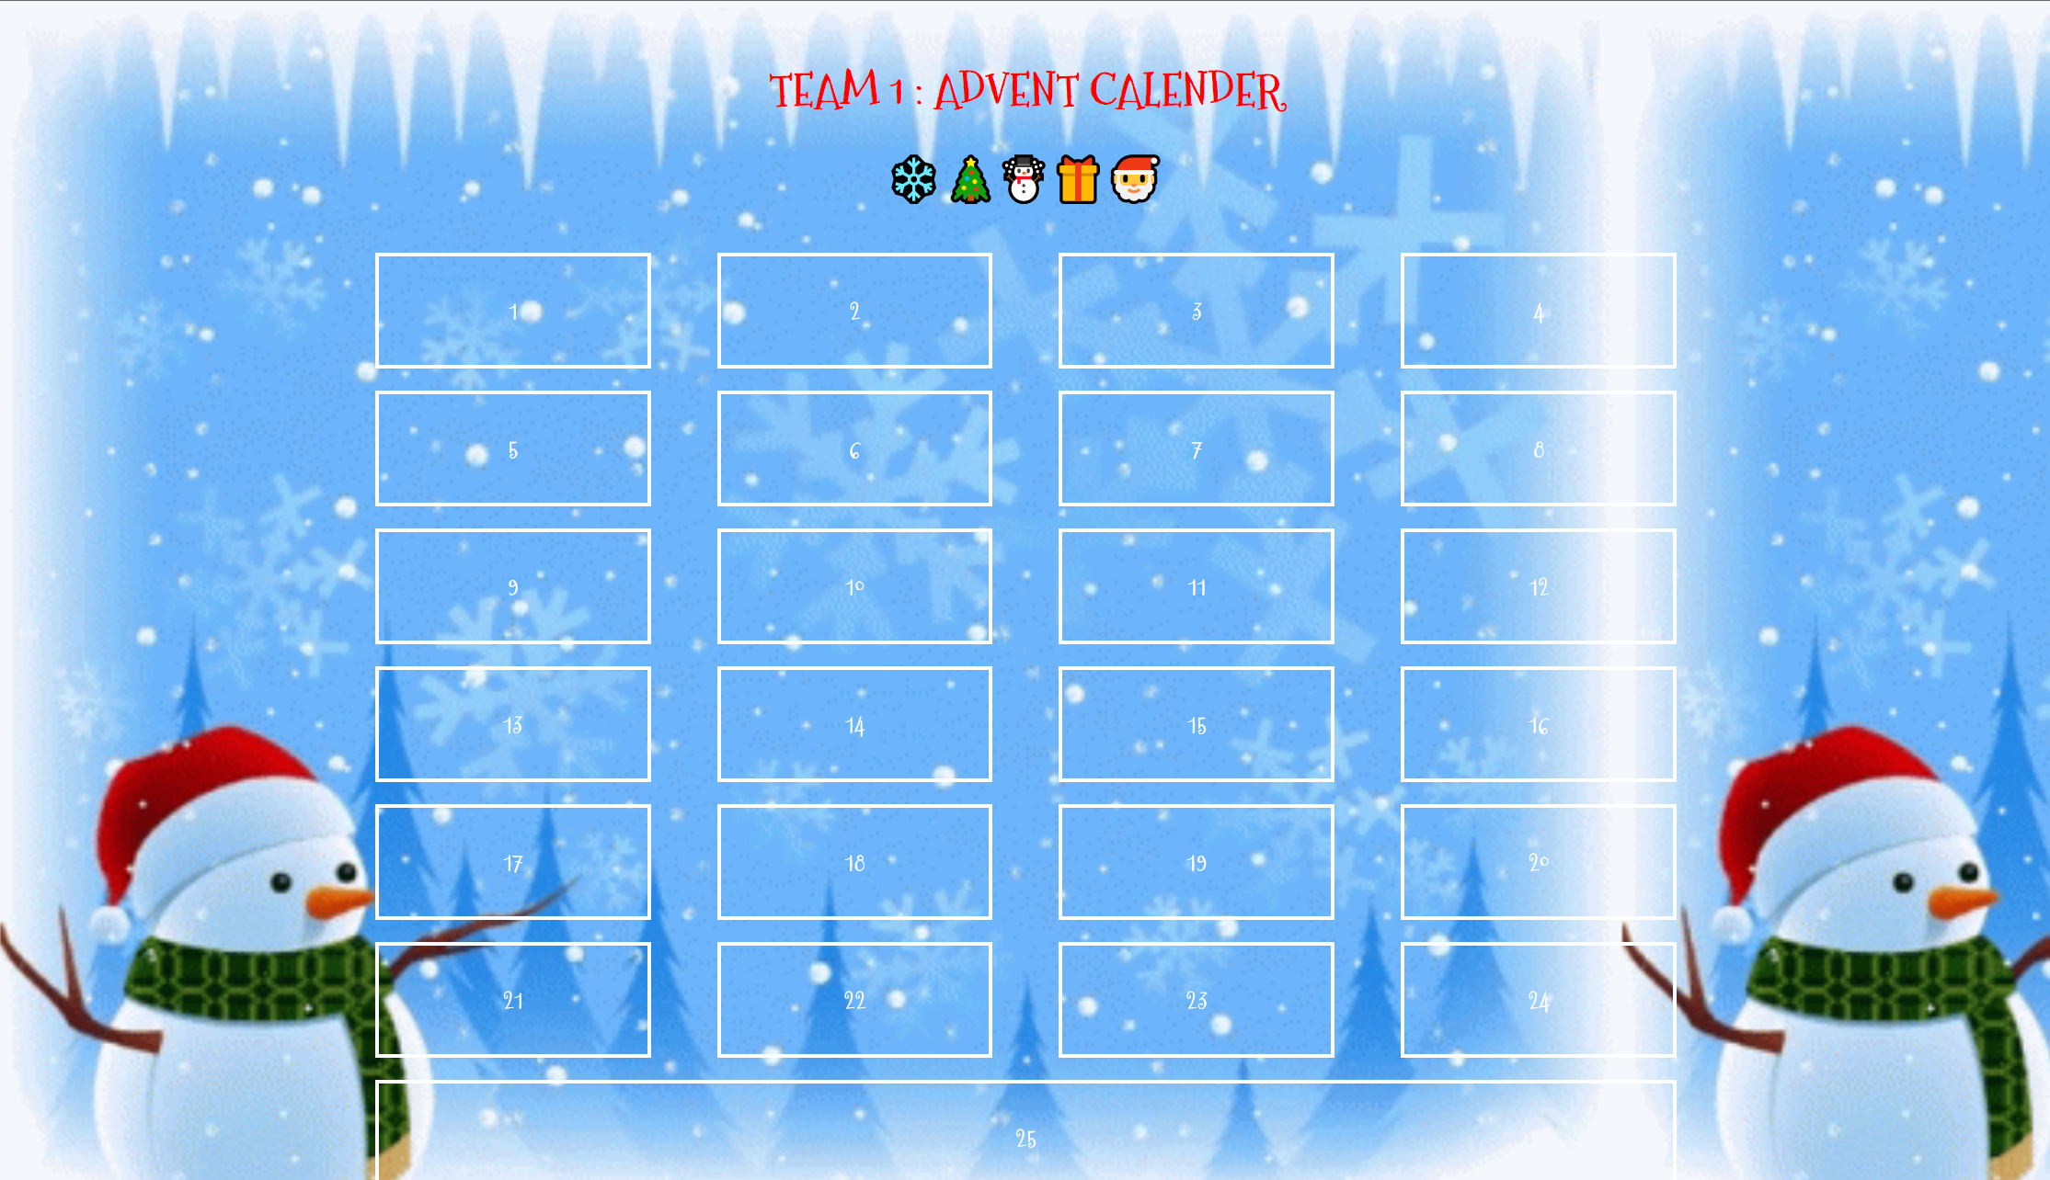
Demo
https://ukrctcs.github.io/Advent-calender-Team-1/

Slide 7
Thanks for listening

